Slide 1



Highlights on Europe Raw Materials Sustainability
Sustainable HEA by Design
www.heraws.eu

Slide 2
Contexte
Materials criticalty required to expand the library of materials to find new materials to substitutes the most critical ones
Thanks to their huge compositional space HEA are a promising platform to find new materials outperforming the existing one
The gigantic number of possible combinations makes trial error approach impossible → AI is needed
For the experimental approach, we need a methods to focus our efforts on the most sustainable options → This is the objective of the present collective study
It is a side project for students involved in HERawS and FEELENTROPIA project
It involves as well your supervisors (Chahrazed and Alex) + 2 International colleagues (Valentin Milichko and Janez Zavasnik)

Slide 3
Method
Chen et al. Published a data base with calculated (DFT) strudcture of all the possible 5 elements equimolar alloys (from the transition metals – 40 elements). Amongst the 650 000 possible alloys 30000 have been identified as possible HEA
We will analyse the sustainability of the 30000 possible HEA to extract a TOP 500
650 000 possible equimolar alloys calculated by Chen
Chen et al.
HERawS simplified Database
30000 predicted HEA
TOP 500

Slide 4
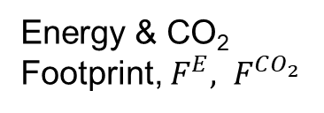

What we need to do
HERawS students have to complete the following database:
Chemical elements tested by Chen et al.
Energy & CO₂ Footprint, ${F^{E}, F}^{CO_{2}}$
Source: Granta EduPack (when available save the reference). Convert CO₂/kg in CO₂/mol
Student(s) in charge: Danielle
HHI & ESG Score
$$ESG=E+S+G$$
Source: USGS (link here) + Lebre et al. Nat. Comm (link here)
Student(s) in charge: Huong
Companionality, C
Source: Nassar et al. Sci. Adv. (link here) (when available save the reference),
Student(s) in charge: Outhmane
Sustainability Indicators
Level of Production
P
Source: USGS (link here)
Student(s) in charge: Wassim ½ + Outhmane ½
Level of reserve, R
Source: USGS (link here)
Student(s) in charge: Wassim ½ + Outhmane ½

Slide 5
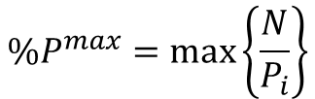
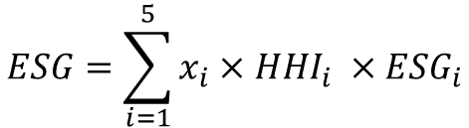
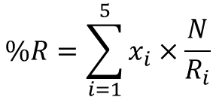
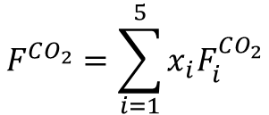
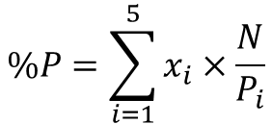

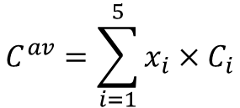
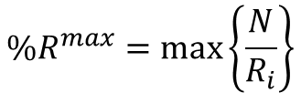
What we need to do
2.Calculate the features for the 30 000 HEAs of Chen database:
SEE updated formula in the Methods section of the draft
$$F^{CO_{2}}=\sum_{i=1}^{5}{{x_{i}F}_{i}^{CO_{2}}}$$
$$ESG=\sum_{i=1}^{5}{x_{i}×HHI_{i} ×ESG_{i}}$$
x_{i} is the molar concentration of the element i
N is a forecasted mass of materials to be substituted (will be provided by Janez and Alex)
$$C^{av}=\sum_{i=1}^{5}{x_{i}×C_{i}}$$
$$C^{max}=\max\left\{C_{i}\right\}$$
$$\%P=\sum_{i=1}^{5}{x_{i}×\frac{N}{P_{i}}}$$
$$\%R=\sum_{i=1}^{5}{x_{i}×\frac{N}{R_{i}}}$$
$${\%P}^{max}=\max\left\{\frac{N}{P_{i}}\right\}$$
$${\%R}^{max}=\max\left\{\frac{N}{R_{i}}\right\}$$
https://matthey.com/documents/161599/509428/PGM-market-report-May-2022.pdf/542bcada-f4ac-a673-5f95-ad1bbfca5106?t=1655877358676

Slide 6




What we need to do
3.Plot the distribution functions
Pt - Primary
$$F^{CO_{2}}, kg.mol^{−1}$$
Pt - Primary
$$Prod \%$$
10%
10%
10%
$$F^{E}, MJ.mol^{−1}$$
10%
$$Reserve \%$$
% to be adjusted upon data
% to be adjusted upon data

Slide 7




What we need to do
3.Plot the distribution functions
4. Select the best alloys ))))
Pt - Primary
$$HHI$$
$$C^{max} \%$$
10%
10%
10%
$$ESG$$
10%
$$C^{av}\%$$
% to be adjusted upon data
% to be adjusted upon data

Slide 8
Discussion
4. Select the best HEAs:
Need to sort the alloys for every parameter
Sort them into Decile (D1; D2….D10) or to Quartile (Q1, Q2, Q3, Q4)
Plot the number of HEA depending on the Decile ( point 3 means the number of HEA that are either in D1, D2 or D3 for every criteria
30000 HEA
Number of HEA
1
2
3
4
5
6
7
8
9
10
Decile

Slide 9
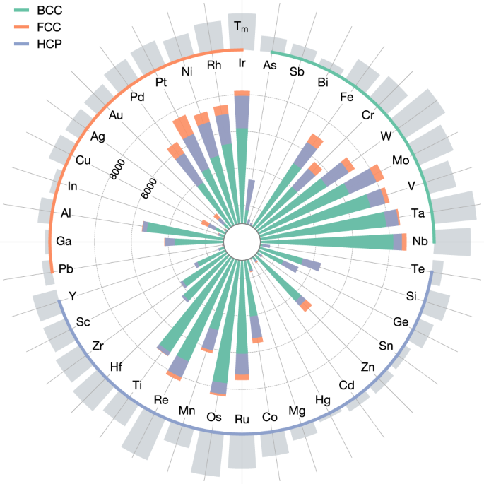
Discussion
Always in Decile 1
Always in Decile 10
Which elements are the most/least represented in the TOP 500?
Which elements are the most/least represented in the worth 500?

Slide 10
What we need to do
5. Implement the calculation on either Sasha’s app or Aymane’s (or both
The User create an alloy (potentially with more than 5 éléments and in non equimolar conctrtation
Comparision with the 30000 alloys: Show to the user in which Decile the alloy is, according to the criteria
Calculation of sustainability criteria
Overall score: D1 = 1 point etc…
If total is between 0 and 10: Highest sustainability
10 – 25 : Very Good
25 – 50: Fair
50 – 75: critical
75 – 100: Highly critical

Slide 11
Conclusion
This is a side project you can join on a voluntary basis on top of your respective project
You have to work collectively and dedicate a reasonnable amount of time (not to delay your own project)
The topic is « burning » and we should plan to submit a paper rapidly (end of summer)
Any participant providing a substantial contribution will be co-author

